Slide 1

MANAGING REGRESSION
Subject: Software Engineering: Software Processes
Presented by: Jenil Arvindbhai Paladiya
Matriculation Number : 4243558

Slide 2
Index
Managing Regression in Software Development
What is Regression?
Why Regression Happens
The Cost of Regression Bugs
Regression Testing: The First Line of Defense
Building a Regression Test Suite
Automating Regression Tests
CI/CD and Regression
Strategies for Preventing Regression
Conclusion: Embrace Regression Management

Slide 3
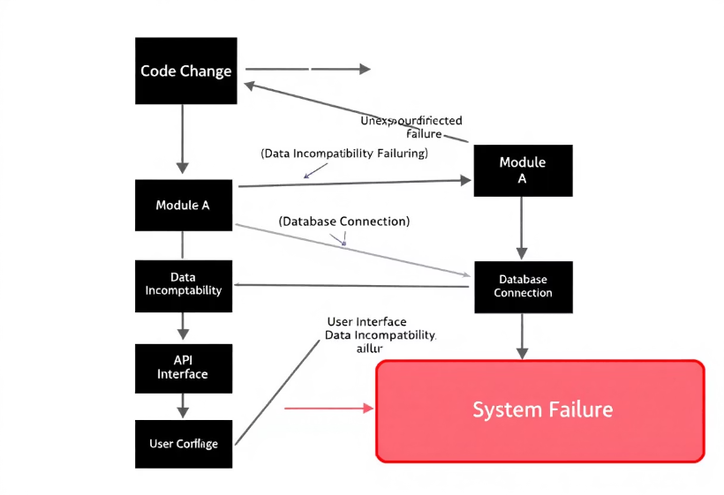
What is Regression?
Definition
Regression occurs when a new change introduces bugs in previously working functionality.
Example
Updating a WordPress plugin breaks the checkout page on an e-commerce site.
It's crucial to catch these regressions early in the development cycle to avoid costly fixes later.

Slide 4




Why Regression Happens
Code Changes
Lack of Testing
Changes affect unexpected areas of the codebase.
Inadequate testing leads to missed regressions.
Tight Deadlines
Time constraints result in development shortcuts.
Poor communication, technical debt, and complexity all contribute to regression issues.

Slide 5




The Cost of Regression Bugs
Financial Impact
Reputation Damage
Time Wasted
Revenue loss and expenses for bug fixes.
Loss of user trust due to poor software quality.
Debugging and fixing issues delays releases.
The 2017 Equifax breach, due to a regression bug, cost over $1.4 billion.

Slide 6




Regression Testing: The First Line of Defense
Definition
Re-running tests after code changes.
Goal
Verify existing functionality still works correctly.
Methods
Manual vs. Automated testing strategies.
The primary focus is to identify regressions early in the development cycle.

Slide 7

Building a Regression Test Suite
Critical Functionalities
Risk and Impact
Test Coverage
Identify and prioritize tests for core features.
Focus on high-risk areas that impact users.
Aim for broad coverage of scenarios and edge cases.
Example: E-commerce suite: login, search, add to cart, checkout.

Slide 8
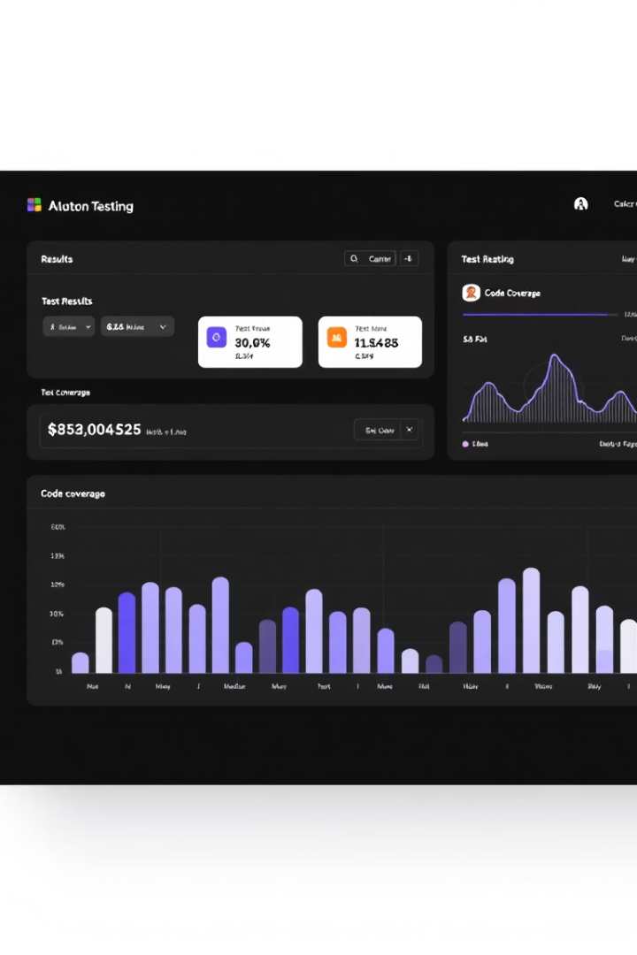
Automating Regression Tests
1
Benefits
Speed, repeatability, and improved efficiency.
2
Tools
Selenium, Cypress, JUnit, TestNG.
3
CI/CD
Continuous Integration/Continuous Deployment.
Automated tests can be set to run on every code commit.

Slide 9



CI/CD and Regression
Immediate Feedback
2
Detect regressions early in the process.
Automated Tests
1
Run tests at each build in the pipeline.
Catch Issues
Prevent bugs from reaching production.
3
Tools like Jenkins, GitLab CI, and CircleCI facilitate faster development cycles.

Slide 10
Strategies for Preventing Regression
Code Reviews
1
Peer reviews by other developers.
Unit Testing
2
Test individual components.
Integration Testing
3
Test between modules.
Clear requirements, specifications, and detailed documentation are crucial for prevention.

Slide 11

Conclusion: Embrace Regression Management
100%
High
Regression is inevitable.
Invest in testing and automation.
Continuous
Improve processes regularly.
Effective management leads to high-quality software and user satisfaction.

Slide 12

Thank You
Presented by Jenil Arvindbhai Paladiya.

